Slide 1
Topics: Advanced Uses of Pointers, Chapter 17
Dynamic Storage Allocation
Memory Allocation Functions
Dynamically Allocated Arrays and Strings
Deallocating Storage
Linked List
Dynamic storage allocation is especially useful for building lists, trees, graphs, and other linked data structures

Slide 2
Linked List

Slide 3
Linked Lists
A linked list consists of a chain of structures (called nodes), with each node containing a pointer to the next node in the chain:
The last node in the list contains a null pointer (NULL).
NULL

Slide 4
Linked Lists
A linked list is more flexible than an array: we can easily insert and delete nodes in a linked list, allowing the list to grow and shrink as needed.
On the other hand, we lose the “random access” capability of an array:
Any element of an array can be accessed in the same amount of time.
Accessing a node in a linked list is fast if the node is close to the beginning of the list, slow if it’s near the end.

Slide 5
Declaring a Node Type
To set up a linked list, we’ll need a structure that represents a single node.
A node structure will contain data (an integer in this example) plus a pointer to the next node in the list:
struct node {
int value; /* data stored in the node */
struct node *next; /* pointer to the next node */
};

Slide 6
Declaring a Node Type
Next, we’ll need a variable that always points to the first node in the list:
struct node *first = NULL;
Setting first to NULL indicates that the list is initially empty.

Slide 7
Creating a Node
As we construct a linked list, we’ll create nodes one by one, adding each to the list.
Steps involved in creating a node:
Allocate memory for the node.
Store data in the node.
Insert the node into the list.

Slide 8
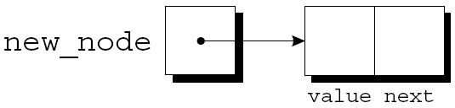
Allocate memory for the node
When we create a node, we’ll need a variable that can point to the node temporarily:
struct node *new_node;
We’ll use malloc to allocate memory for the new node, saving the return value in new_node:
new_node = malloc(sizeof(struct node));
new_node now points to a block of memory just large enough to hold a node structure:

Slide 9

Store data in the node
Next, we’ll store data in the value member of the new node:
(*new_node).value = 10;
The resulting picture:
The parentheses around *new_node are mandatory because the . operator would otherwise take precedence over the * operator.

Slide 10
The -> Operator
Accessing a member of a structure using a pointer is so common that C provides a special operator for this purpose.
This operator, known as right arrow selection, is a minus sign followed by >.
Using the -> operator, we can write
new_node->value = 10;
instead of
(*new_node).value = 10;

Slide 11
The -> Operator
A scanf example using the -> operator:
scanf("%d", &new_node->value);

Slide 12
Searching a Linked List
A loop that visits the nodes in a linked list, using a pointer variable p to keep track of the “current” node:
for (p = list; p != NULL; p = p->next)
…
A loop of this form can be used in a function that searches a list for an integer n.

Slide 13
Searching a Linked List
If it finds n, the function will return a pointer to the node containing n; otherwise, it will return a null pointer.
struct node *search_list(struct node *list, int n)
{
struct node *p;
for (p = list; p != NULL; p = p->next)
if (p->value == n)
return p;
return NULL;
}

Slide 14
Exercise
Given a linked list of node declared as follows, which of the following conditions checks if p is pointing to the first node of the linked list named list.
struct node
{
int number;
struct node *next;
};
p==list
p==NULL
p->next == NULL
p== list->next

Slide 15
Exercise
Given a linked list of node declared as follows, which of the following conditions checks if p is pointing to the last node of the linked list named list.
struct node
{
int number;
struct node *next;
};
p==list
p==NULL
p->next == NULL
p== list->next

Slide 16
Example Program
Count the number of nodes in a linked list that contains number n.

Slide 17
Operations on a linked list
Search a node
Insert a node
Clear the list
Next lecture on linked list:
Delete a node
Insert into an ordered list

Slide 18
Inserting a Node at the Beginning of a Linked List
One of the advantages of a linked list is that nodes can be added at any point in the list.
However, the beginning of a list is the easiest place to insert a node.
Suppose that new_node is pointing to the node to be inserted, and first is pointing to the first node in the linked list.

Slide 19
Inserting a Node at the Beginning of a Linked List
It takes two statements to insert the node into the list.
The first step is to modify the new node’s next member to point to the node that was previously at the beginning of the list:
new_node->next = first;
The second step is to make first point to the new node:
first = new_node;
These statements work even if the list is empty.

Slide 20
Inserting a Node at the Beginning of a Linked List
A function that inserts a node containing n into a linked list, which pointed to by list:
struct node *add_to_list(struct node *list, int n)
{
struct node *new_node;
new_node = malloc(sizeof(struct node));
if (new_node == NULL) {
printf("malloc failed in add_to_list\n");
return list;
}
new_node->value = n;
new_node->next = list;
return new_node;
}

Slide 21
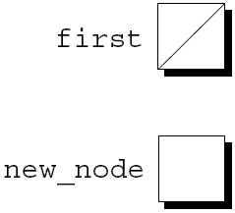
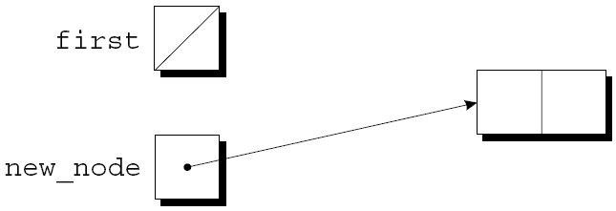
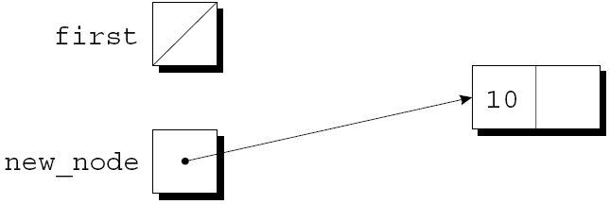
Inserting a Node at the Beginning of a Linked List
first = NULL;
new_node =
malloc(sizeof(struct node));
new_node->value = 10;

Slide 22
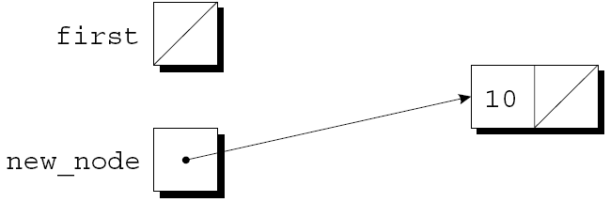
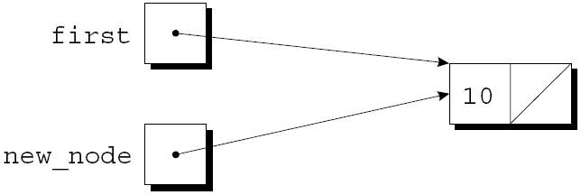
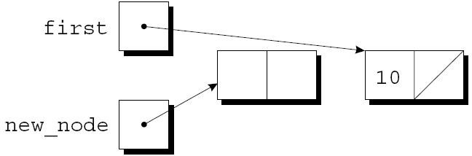
Inserting a Node at the Beginning of a Linked List
new_node->next = first;
first = new_node;
new_node =
malloc(sizeof(struct node));

Slide 23
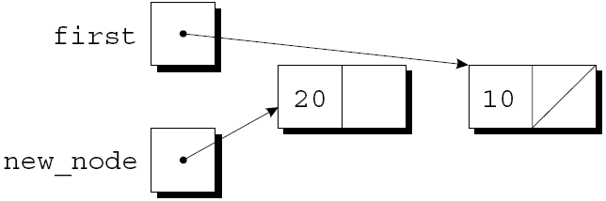
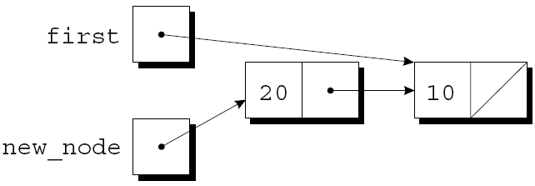
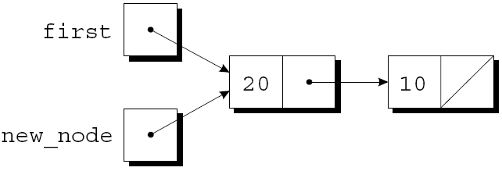
Inserting a Node at the Beginning of a Linked List
new_node->value = 20;
new_node->next = first;
first = new_node;

Slide 24
Main function that calls add_to_list
int main()
{
struct node *first = NULL;
int number, count = 0;
/* inserting nodes */
first = add_to_list(first, 35);
first = add_to_list(first, 6);
first = add_to_list(first, 98);
return 0;
}

Slide 25
Inserting a Node at the Beginning of a Linked List
Note that add_to_list returns a pointer to the newly created node (now at the beginning of the list).
When we call add_to_list, we’ll need to store its return value into first:
first = add_to_list(first, 10);
first = add_to_list(first, 20);

Slide 26
Return the Pointer
Getting add_to_list to update first directly, rather than return a new value for first, turns out to be tricky.
Suppose we add the statement
list = new_node;
instead of return new_node;
Will not work because pointers, like all arguments, are passed by value, so first in the add_to_list function is a local variable. Updating a local variable does not update first
26

Slide 27
Example Program
Run the linked list program and check the order of the numbers inserted to the linked list.

Slide 28
Clear the List
Before the program terminates, we should release the memory that was occupied by the nodes in the linked list.
void clear_list(struct node *list)
{
struct node *p;
while(list != NULL)
{
p = list;
list = list->next;
if( p!= NULL)
free(p);
}
}

Slide 29
Exercise: Clear the List
What’s wrong with the following function?
void clear_list(struct node *list)
{
struct node *p;
for(p = list; p != NULL; p = p->next)
free(p);
}
Memory leak
Dangling pointer
Both A and B

Slide 30
Exercise #1
Complete the following function:
struct node *find_largest(struct node *list);
The list parameter points to a linked list. The function should return a pointer to the node that contains the largest value; it should return NULL if the list is empty.
Download linked_list.c on Canvas from this week’s In-class Exercises folder.
Fill in the code for the function in linked_list.c. Add statements in the main function to test it.

Slide 31
Exercise #2
Complete the following function:
int duplicates(struct node *list);
The list parameter points to a linked list. The function should return 1 if the list contains duplicated nodes; otherwise returns 0. Assume that the node structure is declared as:
struct node {
int value; /* data stored in the node */
struct node *next;
/* pointer to the next node */
};
Fill in the code for the function. Add statements in the main function to test it.

